Slide 1
Lecture 4 Ohm’s Law

Slide 2
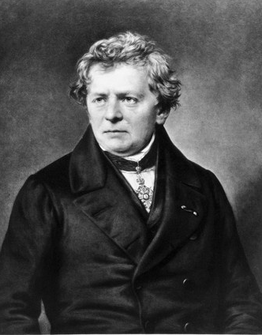
Introduction
The Ohms law was first established by a German physicist named Georg Simon Ohm and was the most important theory that described the quantitative characteristics of the physics of electricity.
The law is useful in carrying out calculations such as in determining the value of resistors or the current in a circuit or in measuring the voltage.

Slide 3

Ohm’s Law
Ohm’s law states that potential difference (V) across the ends of conductors is proportional to the current (I) flowing between them
V ∝ I
Therefore, V = R I where R is a constant called resistance.
The resistance R of an element denotes its ability to resist the flow of electric current; it is measured in ohms
R= $\frac{V}{I}$
Suppose the external conditions of the element are altered, e.g., changes in the temperature ,the resistance can change.

Slide 4

Resistivity
The resistance of any material with a uniform cross-sectional area A ,depends on A and its length l, We can represent resistance in mathematical form,
Where ρ is known as the resistivity of the material
Unit of resistivity is ohm-metre.

Slide 5
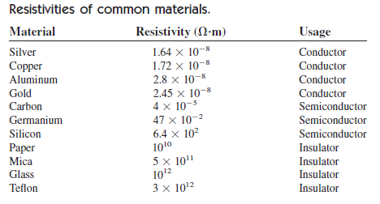
Resistivity
Good conductors, such as copper and aluminum, have low resistivities, while insulators, such as mica and paper, have high resistivities. Table 1
presents the values of for some common materials and shows which
materials are used for conductors, insulators, and semiconductors.
Table.1

Slide 6
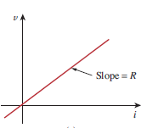
Linear resistor
All resistors does not obey Ohm’s law. A resistor that obeys Ohm’s law is known as a linear resistor or Ohmic devices.
It has a constant resistance and its current-voltage characteristic is as illustrated in Fig. 1
Fig. 1
Its i-v graph is a straight line passing through the origin.

Slide 7
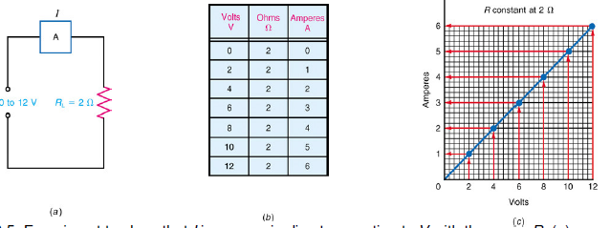
Linear resistor-Example
The Ohm’s Law formula I = V/R states that V and I are directly proportional for any value of R.
Experiment to show that I increases in direct proportion to V with the same R. (a) Circuit with variable V but constant R. (b) Table of increasing I for higher V. (c) Graph of V and I values.
This is a linear volt-ampere characteristic. It shows a direct proportion between V and I.

Slide 8
V = IR
When V is constant
I decreases as R increases.
I increases as R decreases.
Examples:
If R doubles, I is reduced by half.
If R is reduced to ¼, I increases by 4.

Slide 9
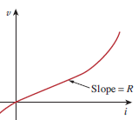
Non Linear resistor
A nonlinear resistor or non ohmic devices does not obey Ohm’s law. Its resistance varies with current and its i-v characteristic is typically shown in Fig. 2.
Fig. 2
Examples of device with nonlinear resistance is diode. All practical resistors may exhibit nonlinear behavior under certain conditions.

Slide 10

Non Linear resistor
In a nonlinear resistance, increasing the applied V produces more current, but I does not increase in the same proportion as the increase in V.
As the tungsten filament in a light bulb gets hot, its resistance increases

Slide 11

Non Linear resistor
Another nonlinear resistance is a thermistor.
A thermistor is a resistor whose resistance value changes with its operating temperature.
As an NTC (negative temperature coefficient) thermistor gets hot, its resistance decreases.

Slide 12

Conductance
The conductance is a measure of how well an element will conduct electric current.
It is reciprocal of resistance R, known as conductance and denoted by G:
The unit of conductance is the mho or siemens (S).

Slide 13


Power
The power dissipated by a resistor can be expressed in terms of R.
The power dissipated by a resistor can be expressed in terms of G.
The power dissipated in a resistor is a nonlinear function of either current or voltage

Slide 14
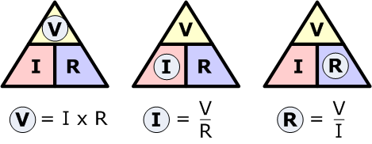
Ohm’s Law Triangle
Ohm’s law formulas given above can be easily remembered using the Ohm’s law triangle. This triangle helps us to easily represent the interchangeability of the equations.
We can take a triangle and divide it into three parts. Then we can input the values, V, I, R into the triangle. V on top, I on the left side and R on the right side.

Slide 15
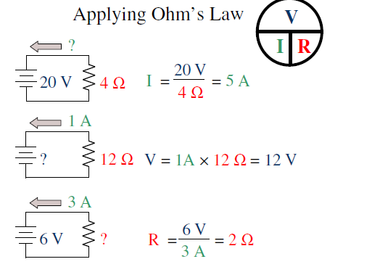
Ohm’s Law- Example

Slide 16
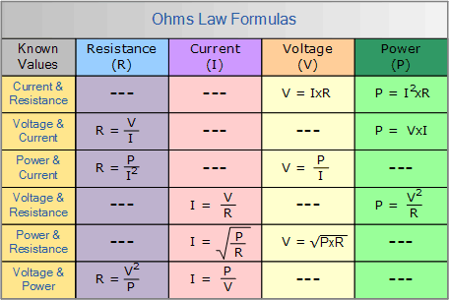
Ohm’s Law (Calculation of V,I,R &P)

Slide 17

Problem.1
Problem.1
An electric iron draws 2 A at 120 V. Find its resistance.
From Ohm’s law,

Slide 18
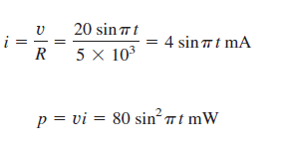
Problem.2
Problem.2
A voltage source of 20 sinπt V is connected across a 5-kΩ resistor. Find the current through the resistor and the power dissipated.

Slide 19
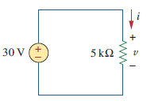


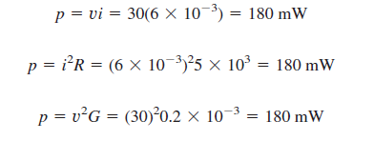
Problem.3
Problem.3
In the circuit shown in Fig. 2, calculate the current i, the conductance G, and the power p.
Fig.2

Slide 20
Application &Limitation
Application-Electrical appliances
Ohm’s law holds true only for a conductor at a constant temperature. Resistivity changes with temperature.
Some materials are non-ohmic under a weak electric field.
Joules heat is given by H = I²Rt where I is current, R is resistance and t is time. As long as the current flows, greater will be the temperature of the conductor.

Slide 21
Reference
Edward Hughes. “Electrical and Electronic Technology”, 10th Edition, Pearson Education Asia, 2019.
Charles K. Alexander and Matthew N. O. Sadiku. “ Fundamentals of Electric Circuits”, 5 th Edition, Tata McGraw Hill, 2012

Slide 22
Thank You

